Slide 1




Form 700.04 (Chapter 7)

Slide 2

FORM 700.04
This form is the reporting form for ready mix concrete batches. It is used for QC/QA purposes for acceptance , recording and monitoring:
Concrete origin, load, time on site, and mixing information
Used to make sure that the delivered concrete is within acceptable limits of SCDOT Specifications
Record of the plastic properties of the concrete (air, slump, re-tempering with water and chemical additions of the concrete on site)
Actual concrete mix versus design proportions

Slide 3
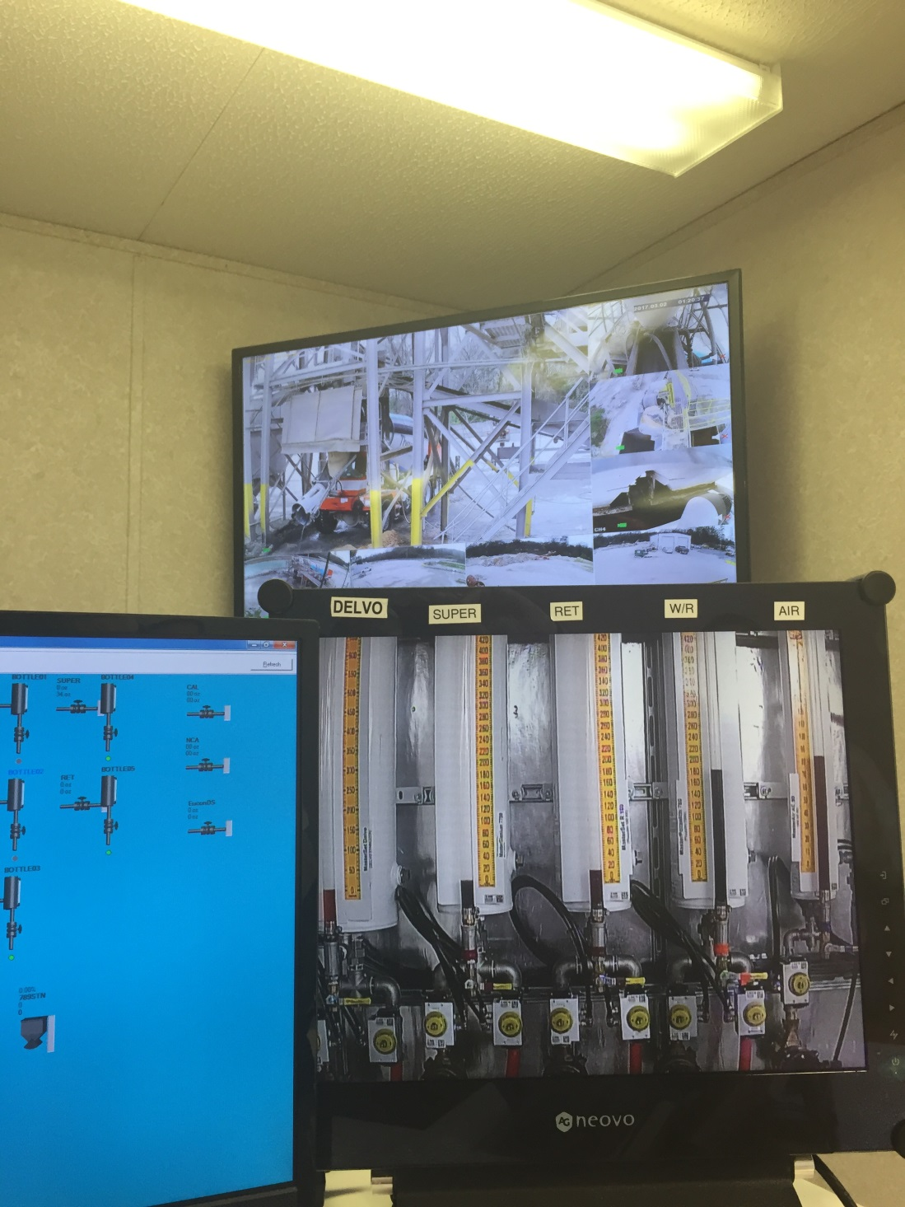
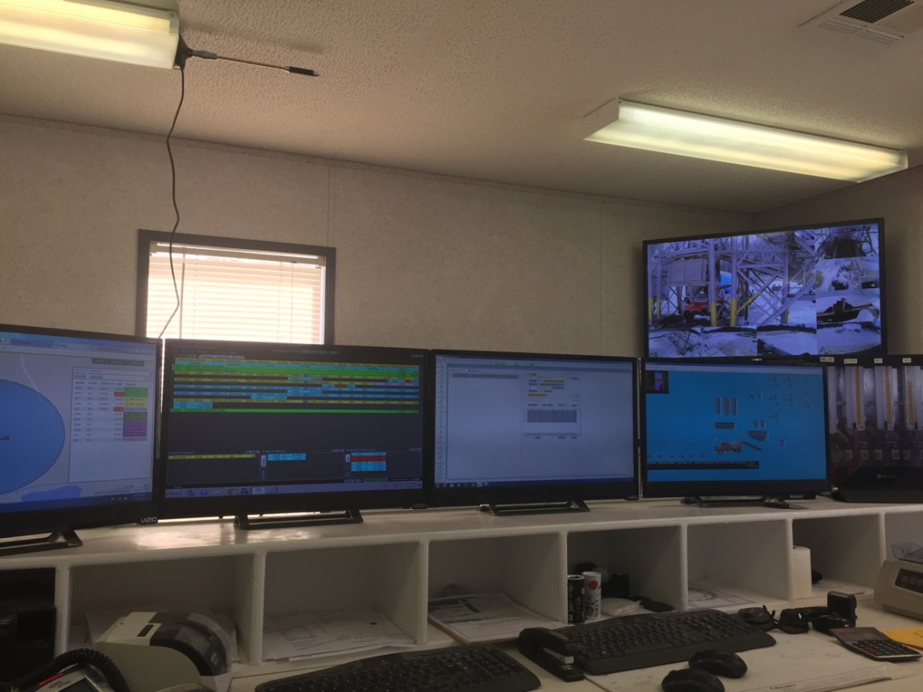
Concrete Batch Plants are starting to keep up with technology and it is getting easier to access the information you need.

Slide 4
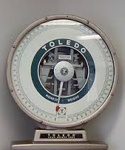
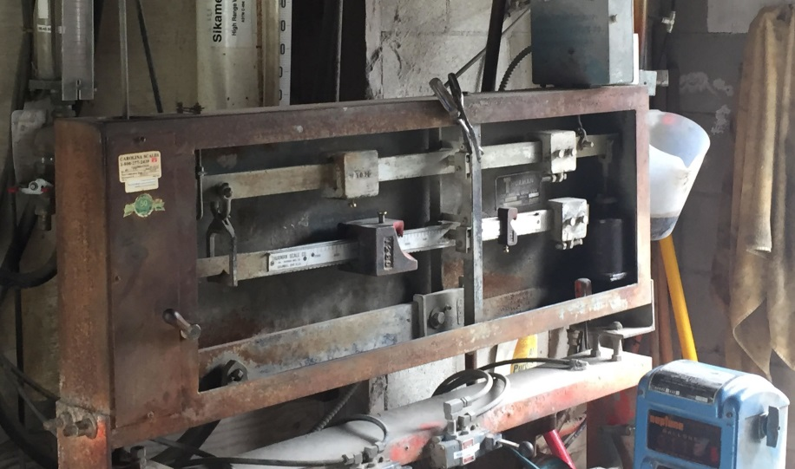
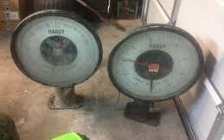
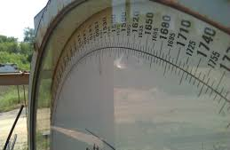
Remember, some plants still use dial scales and beam balances and they are acceptable. No printable batch ticket will be available and material weights will be determined by reading the scale values from the dial gauges or beam balances.
Also remember that some plants weigh water and some use volumetric methods (typically gallons.)

Slide 5
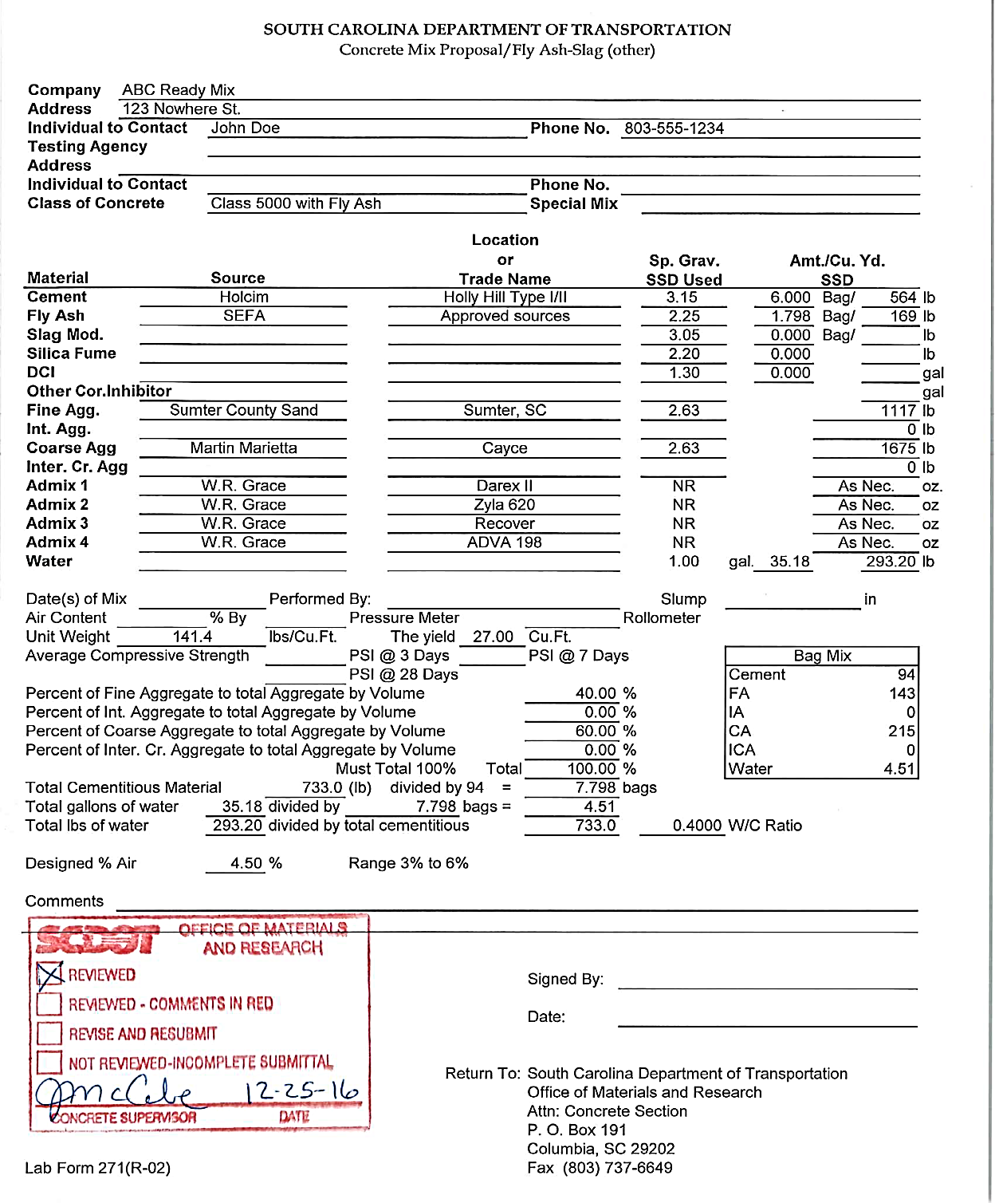

Lab Form 271 (R-02) OR Equivalent shall be stamped as Reviewed by the OMR.
“
701.2.5.11 after successful review of a mix design by the OMR, do not change the mix proportions for the concrete of that class unless modifications are necessary and are approved in advance.
”

Slide 6
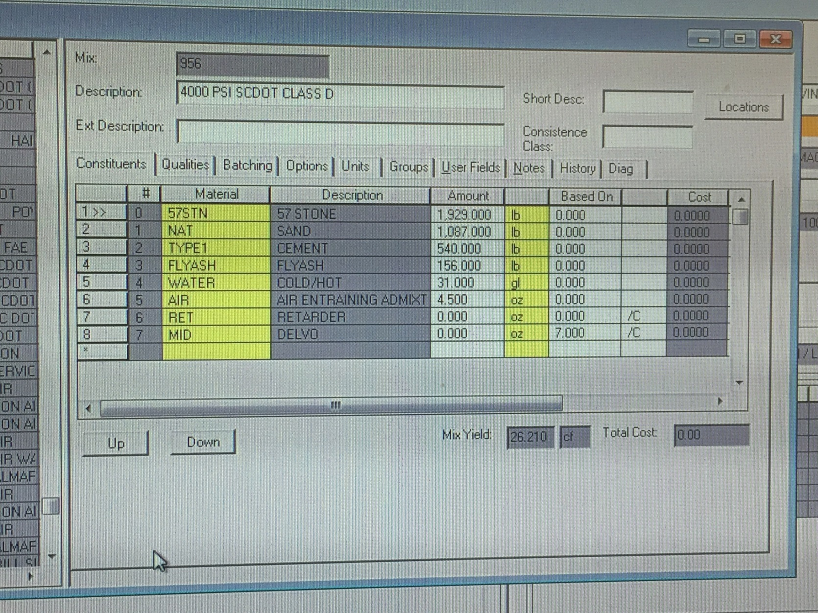
From the Batch Panel Screen, they can pull up the SSD Mix Design that is being used. You can see that this is Mix: 956 ….
Are the same mix proportions used on the Form 271 (R-02)?

Slide 7
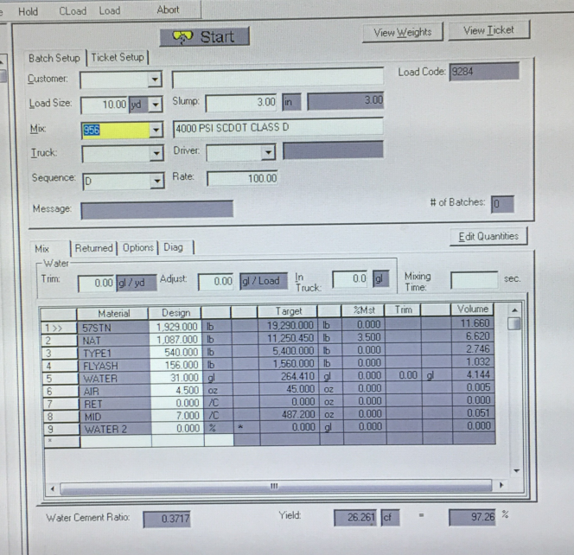
The theoretical batch weights adjusted for the aggregate moistures can be obtained from the batch computer screen or a printout of the batch ticket.

Slide 8
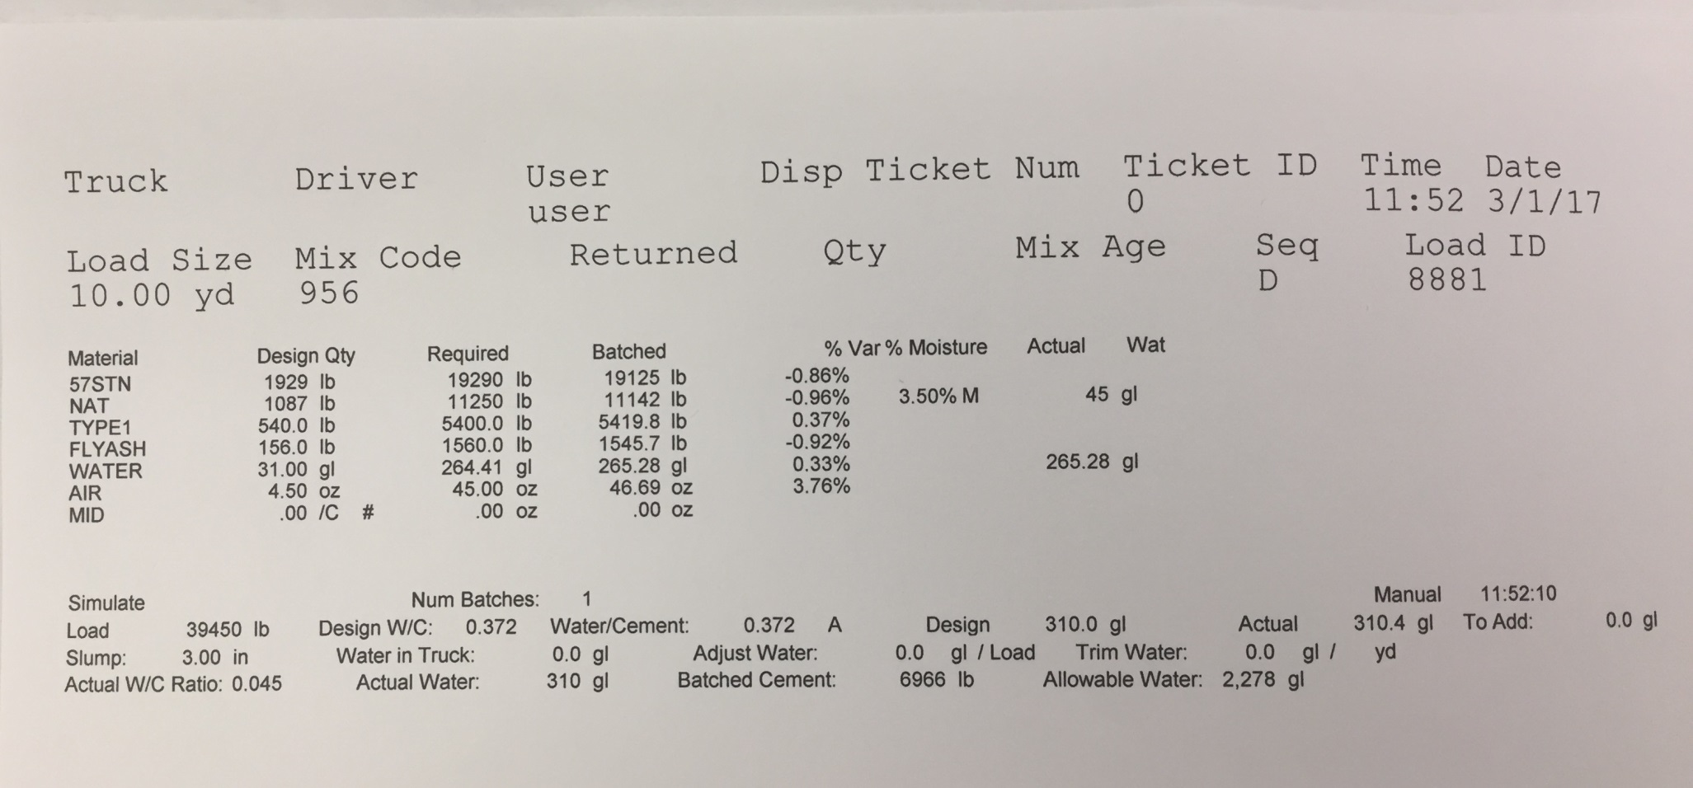
Unless the Batch Ticket has been approved by the OMR for use as an alternative to the 700.04 (Supplemental Specification *****)…
The values at the bottom of the batch ticket shall not be used!

Slide 9
FORM 700.04 - EXAMPLE Q1
STEP 1. Read the Problem Statement.
Total Concrete required for the pour:
30 cubic yards, delivered by six trucks carrying five cubic yards each.
Class 5000 Concrete with 13% Fly Ash
AGGREGATES | AGGREGATE TYPE | SPECIFIC GRAVITY | MOISTURE PERCENTAGE
COARSE | Crushed Stone | 2.65 | 0.50%
FINE | Sand | 2.62 | 4.0%
ADMIXTURE | DOSAGE RATE
Air Entrainer | 0.60 oz/bag
Water Reducer | 2.50 oz/100 lbs.
Cement Scale | 4000 lbs. MAX
Aggregate Scale | 25,000 lbs. MAX
** Remember that we need the Type of coarse aggregate so we can get the correct w/c ratio from the Structural Concrete Table **

Slide 10
BATCH TICKET PRINTOUT OR BATCH COMPUTER SCREEN
STEP 2. Find the appropriate batch ticket paying attention to class and additional cementitious materials.
 |  |  |  | DISPATCH TICKET NUMBER
 | TRUCK # | FILE # | USER |  | TICKET ID | BATCH TIME | DATE
 | 46 | 10.426 | C. Breeze | 159587 | 20907 | 12:06 | 10/31/2016
 |  | LOAD SIZE | MIX CODE | RETURNED QUANTITY | CUMMULATIVE YARDS
 |  | 5.00 CY | 31614E D | 0 | 10 Y
 |  | MATERIAL | DESIGN QTY (SSD/YD) | TARGET WEIGHT | BATCHED | % Var | % Moisture
 |  | Coarse Agg | 1844 lb | 9175 lb | 9267 lb | 1.00 | 0.50%
 |  | Int Agg |  |  |  |  | 0.00%
 |  | Fine Agg | 1036 lb | 4980 lb | 4905 lb | -1.51 | 4.00%
 |  | Total Agg (lbs) |  | 14155 lb
 |  | Cement | 613 lb | 3065 lb | 3096 lb | 1.01
 |  | Fly Ash | 110 lb | 550 lb | 578 lb | 5.09
 |  | WR | 2.5 oz/ 100 Lbs. | .00 oz | .00 oz
 |  | Air | 0.6 oz/bag | .00 oz | .00 oz
 |  | Water (lbs) | 334 lb | 1425 lb
 |  | Water (gal) |  | 171 gal | 154 gal

Slide 11
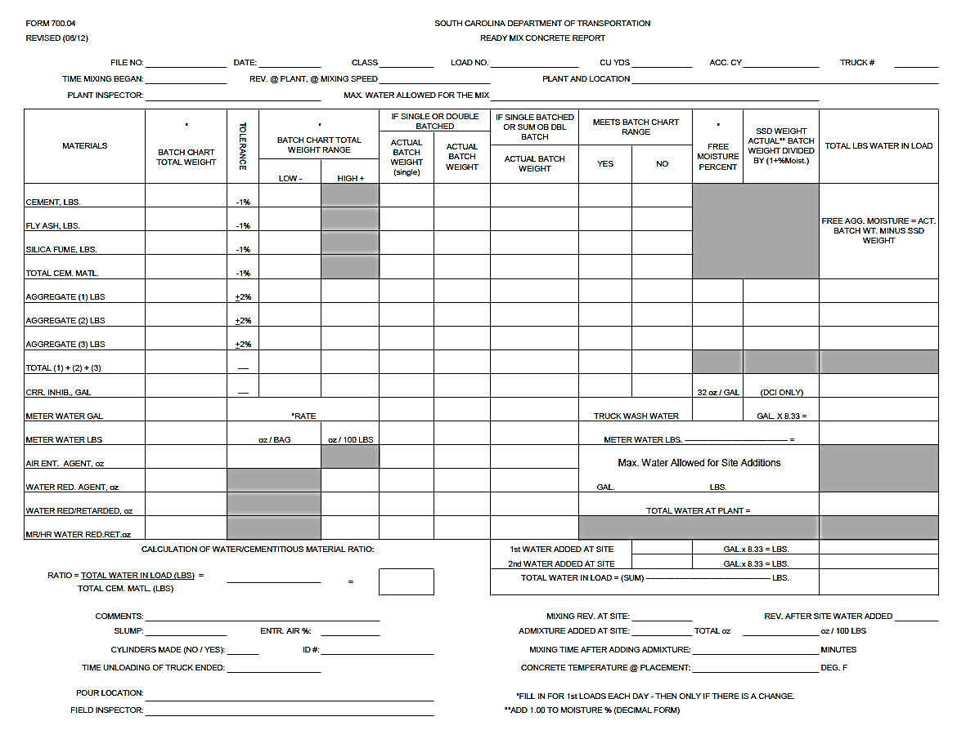

Slide 12
 |  |  |  | DISPATCH TICKET NUMBER
 | TRUCK # | FILE # | USER |  | TICKET ID | BATCH TIME | DATE
 | 46 | 10.426 | C. Breeze | 159587 | 20907 | 12:06 | 10/31/2016
 |  | LOAD SIZE | MIX CODE | RETURNED QUANTITY | CUMMULATIVE YARDS
 |  | 5.00 CY | 31614E D | 0 | 10 Y
 |  | MATERIAL | DESIGN QTY (SSD/YD) | TARGET WEIGHT | BATCHED | % Var | % Moisture
 |  | Coarse Agg | 1844 lb | 9175 lb | 9267 lb | 1.00 | 0.50%
 |  | Int Agg |  |  |  |  | 0.00%
 |  | Fine Agg | 1036 lb | 4980 lb | 4905 lb | -1.51 | 4.00%
 |  | Total Agg (lbs) |  | 14155 lb
 |  | Cement | 613 lb | 3065 lb | 3096 lb | 1.01
 |  | Fly Ash | 110 lb | 550 lb | 578 lb | 5.09
 |  | WR | 2.5 oz/ 100 Lbs. | .00 oz | .00 oz
 |  | Air | 0.6 oz/bag | .00 oz | .00 oz
 |  | Water (lbs) | 334 lb | 1425 lb
 |  | Water (gal) |  | 171 gal | 154 gal
Mix Information As Batched
You must always verify that the SSD Material Weights are the same SSD weights used on the SCDOT Reviewed Mix Design from the OMR. A copy of the SCDOT Approved Mix Design can be obtained from the RCE or the Ready Mix Concrete Plant will have access to the approved design.

Slide 13
 |  |  |  | DISPATCH TICKET NUMBER
 | TRUCK # | FILE # | USER |  | TICKET ID | BATCH TIME | DATE
 | 46 | 10.426 | C. Breeze | 159587 | 20907 | 12:06 | 10/31/2016
 |  | LOAD SIZE | MIX CODE | RETURNED QUANTITY | CUMMULATIVE YARDS
 |  | 5.00 CY | 31614E D | 0 | 10 Y
 |  | MATERIAL | DESIGN QTY (SSD/YD) | TARGET WEIGHT | BATCHED | % Var | % Moisture
 |  | Coarse Agg | 1844 lb | 9175 lb | 9267 lb | 1.00 | 0.50%
 |  | Int Agg |  |  |  |  | 0.00%
 |  | Fine Agg | 1036 lb | 4980 lb | 4905 lb | -1.51 | 4.00%
 |  | Total Agg (lbs) |  | 14155 lb
 |  | Cement | 613 lb | 3065 lb | 3096 lb | 1.01
 |  | Fly Ash | 110 lb | 550 lb | 578 lb | 5.09
 |  | WR | 2.5 oz/ 100 Lbs. | .00 oz | .00 oz
 |  | Air | 0.6 oz/bag | .00 oz | .00 oz
 |  | Water (lbs) | 334 lb | 1425 lb
 |  | Water (gal) |  | 171 gal | 154 gal
Mix Information As Batched
You must also verify that the materials used are from the source that were used on the approved mix design and that they are approved on the current QPL.

Slide 14
STEP 3. Fill in basic batch information at the top of the form.
This includes the:
File Number
Date
Class of Concrete
Load Number
Load Size
Accumulated Load Size
Truck Number
( = Load number x Load Size)

Slide 15
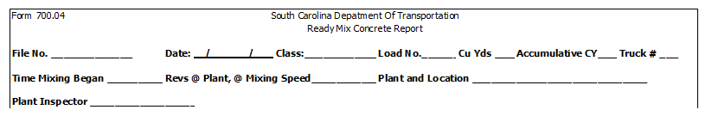
STEP 3. Fill in basic batch information at the top of the form.
This includes the:
File Number
Date
Class of Concrete
Load Number
Load Size
Accumulated Load Size
Truck Number
( = Load number x Load Size)
10.426
03/15/20
5000
2
5
10
11
(Time)
(Revolutions)
(Plant, City, State)
John Q. Doe

Slide 16
STEP 4-8. The Batch Total Weights are given on the appropriate concrete plant batch ticket or the screen of the computer of the batch system. These are the theoretically ideal values for proportioning this specific class of concrete using the prescribed materials.
MATERIALS | * BATCH CHART TOTAL
CEMENT LBS.
FLY ASH LBS.
SILICA FUME LBS.
TOTAL CEM. MATERIAL
AGGREGATE (1) LBS.
AGGREGATE (2) LBS.
AGGREGATE (3) LBS.
TOTAL (1) + (2) + (3)
COR. INHIBITOR GAL
METER WATER GAL ( = GAL x 8.33)
Max Water Allowed for the Mix AS Batched

Slide 17
 |  |  |  | DISPATCH TICKET NUMBER
 | TRUCK # | FILE # | USER |  | TICKET ID | BATCH TIME | DATE
 | 46 | 10.426 | C. Breeze | 159587 | 20907 | 12:06 | 10/31/2016
 |  | LOAD SIZE | MIX CODE | RETURNED QUANTITY | CUMMULATIVE YARDS
 |  | 5.00 CY | 31614E D | 0 | 10 Y
 |  | MATERIAL | DESIGN QTY (SSD/YD) | TARGET WEIGHT | BATCHED | % Var | % Moisture
 |  | Coarse Agg | 1844 lb | 9175 lb | 9267 lb | 1.00 | 0.50%
 |  | Int Agg |  |  |  |  | 0.00%
 |  | Fine Agg | 1036 lb | 4980 lb | 4905 lb | -1.51 | 4.00%
 |  | Total Agg (lbs) |  | 14155 lb
 |  | Cement | 613 lb | 3065 lb | 3096 lb | 1.01
 |  | Fly Ash | 110 lb | 550 lb | 578 lb | 5.09
 |  | WR | 2.5 oz/ 100 Lbs. | .00 oz | .00 oz
 |  | Air | 0.6 oz/bag | .00 oz | .00 oz
 |  | Water (lbs) | 334 lb | 1425 lb
 |  | Water (gal) |  | 171 gal | 154 gal
Mix Information As Batched
The Target Weight is the theoretical weight of the materials that have been adjusted for moisture content for the given size load of concrete.

Slide 18
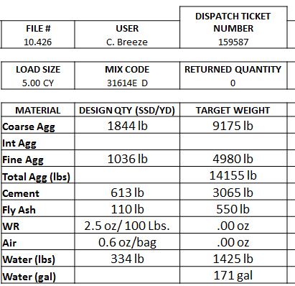
STEP 4-8. The Theoretical Batch Total Weights can be obtained from the Batch Ticket or Batch Computer Screen. These are the theoretically ideal values for proportioning this specific class of concrete using the prescribed materials.
MATERIALS | * BATCH CHART TOTAL
CEMENT LBS.
FLY ASH LBS.
SILICA FUME LBS.
TOTAL CEM. MATERIAL
AGGREGATE (1) LBS.
AGGREGATE (2) LBS.
AGGREGATE (3) LBS.
TOTAL (1) + (2) + (3)
METER WATER GAL ( = GAL x 8.33)
METER WATER LBS
3065
550
“3615”
9175
4980
“14155”
171
1425
Max Water Allowed for the Mix AS Batched

Slide 19
STEP 9. Calculate the allowable weight tolerances as indicated. Round the weights to the nearest pound.
3065 – (.01 x 3065) = 3034
550 x .99 = 545
3615 x .99 = 3579
9175 – (.02 x 9175) = 8992
9175 + (.02 x 9175) = 9359
4980 x 0.98 = 4880 4980 x 1.02 = 5080
MATERIALS | * BATCH CHART TOTAL | TOLERLANCE | * Batch Chart Total
 |  |  | Low - | High +
CEMENT LBS. | 3065 | -1% |  | XXXXX
FLY ASH LBS. | 550 | -1% |  | XXXXX
SILICA FUME LBS. |  | -1% |  | XXXXX
TOTAL CEM. MATL. | 3615 | -1% |  | XXXXX
AGGREGATE (1) LBS. | 9175 | ±2%
AGGREGATE (2) LBS. | 4980 | ±2%
AGGREGATE (3) LBS. |  | ±2%
TOTAL (1) + (2) + (3) | 14155 | ---
COR. INHIBITOR GAL |  | ---
METER WATER GAL | 171 |  | * Rate
METER WATER LBS. | 1425 |  | oz/Bag | oz/100 Lbs
3034
545
3579
8992
8992
9359
4880
5080
There are multiple methods to calculate the low and high values used to bracket the acceptable tolerance. You may use any method you are comfortable with. Two different methods are show above.

Slide 20
STEP 10-11. Obtain the loading/dosage rates for any admixtures to be incorporated into the batch from the problem statement. For this example, the AEA loads at 0.6 oz/bag of cementitious material. Since a bag of cement weighs 94 lbs., the loads rate could be written 0.6 oz/94 lbs. Notice that WRA’s and WRR’s dose per 100 lbs. cementitious material. For this example, the WRA loads at 2.5 oz/ 100 lbs. of cementitious material.
MATERIALS | * BATCH CHART TOTAL | TOLERLANCE | * Batch Chart Total
 |  |  | Low - 3034 545 3579 8992 4880 | High +
CEMENT LBS. | 3065 | -1% |  | XXXXX
FLY ASH LBS. | 550 | -1% |  | XXXXX
SILICA FUME LBS. |  | -1% |  | XXXXX
TOTAL CEM. MATL. | 3615 | -1% |  | XXXXX
AGGREGATE (1) LBS. | 9175 | ±2% |  | 9359
AGGREGATE (2) LBS. | 4980 | ±2% |  | 5080
AGGREGATE (3) LBS. |  | ±2%
TOTAL (1) + (2) + (3) | 14155 | ---
COR. INHIBITOR GAL |  | ---
METER WATER GAL | 171 |  | * Rate
METER WATER LBS. | 1425 |  | oz/Bag | oz/100 Lbs
AIR ENT. AGENT |  |  |  | XXXXX
WATER RED. AGENT |  |  | XXXX
WATER RED/RETARDER |  |  | XXXX
To calculate the amount of AEA to the nearest oz:
(0.60/94) x 3615 = 23 oz
OR
(3615/94) x 0.60 = 23 oz
To calculate the amount of WRA to the nearest oz:
(2.50/100) x 3615 = 90 oz
OR
(3615/100) x 2.5 = 90 oz
23
0.6
90
2.5

Slide 21
STEP 12. Using the batch ticket values (actual proportions that are in the truck or central mixer), fill in the Actual Batch Weight values. Verify that a double batch was/was not required.
 |  |  |  | DISPATCH TICKET NUMBER
 | TRUCK # | FILE # | USER |  | TICKET ID | BATCH TIME | DATE
 | 46 | 10.426 | C. Breeze | 159587 | 20907 | 12:06 | 10/31/2016
 |  | LOAD SIZE | MIX CODE | RETURNED QUANTITY | CUMMULATIVE YARDS
 |  | 5.00 CY | 31614E D | 0 | 10 Y
 |  | MATERIAL | DESIGN QTY (SSD/YD) | TARGET WEIGHT | BATCHED | % Var | % Moisture
 |  | Coarse Agg | 1844 lb | 9175 lb | 9267 lb | 1.00 | 0.50%
 |  | Int Agg |  |  |  |  | 0.00%
 |  | Fine Agg | 1036 lb | 4980 lb | 4905 lb | -1.51 | 4.00%
 |  | Total Agg (lbs) |  | 14155 lb
 |  | Cement | 613 lb | 3065 lb | 3096 lb | 1.01
 |  | Fly Ash | 110 lb | 550 lb | 578 lb | 5.09
 |  | WR | 2.5 oz/ 100 Lbs. | .00 oz | .00 oz
 |  | Air | 0.6 oz/bag | .00 oz | .00 oz
 |  | Water (lbs) | 334 lb | 1425 lb
 |  | Water (gal) |  | 171 gal | 154 gal

Slide 22
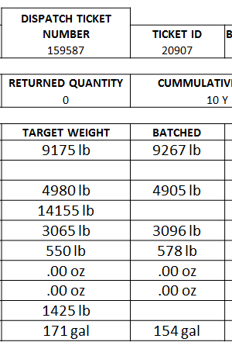
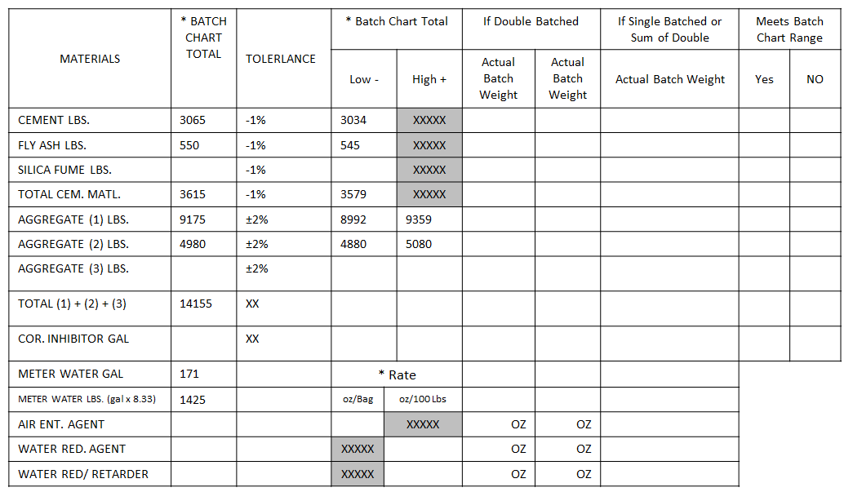
STEP 12. Using the batch ticket values (actual proportions that are in the truck or central mixer), fill in the Actual Batch Weight values. Verify that a double batch was/was not required.
3096
578
9267
4905

Slide 23
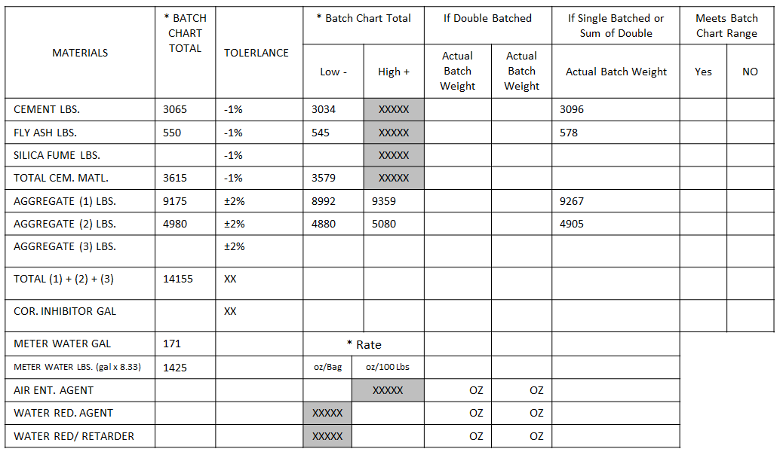
STEP 13. To determine the total cementitious material quantity, add the cement, fly ash and silica fume weights. Place this value in the appropriate space.
3096 + 578 + 0 = 3674
3674

Slide 24
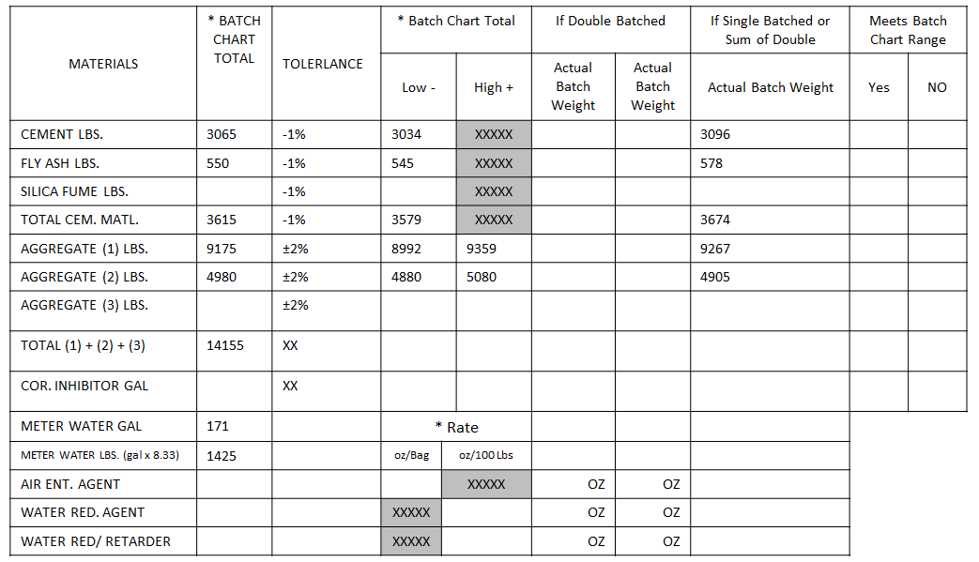
STEP 14. From the batch ticket obtain the actual batched water in gallons from the “Batched” column.
* Some plants weigh water and it will already be given in pounds.
154

Slide 25
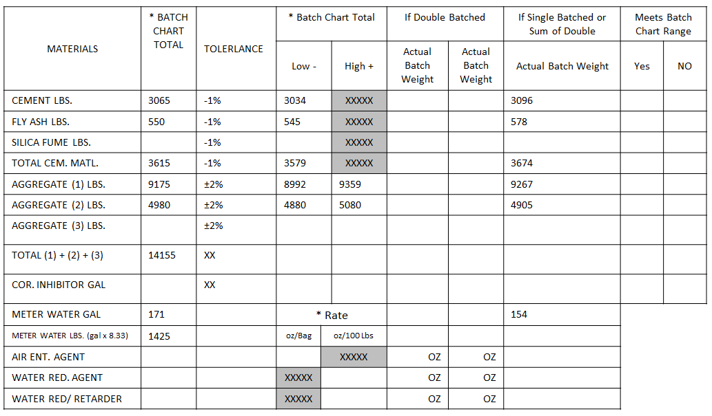
STEP 14. If the batch ticket does not give the weight of water in pounds, take the number of gallons and multiply by 8.33 to get the pounds to the nearest whole number.
154 x 8.33 = 1283
1283

Slide 26
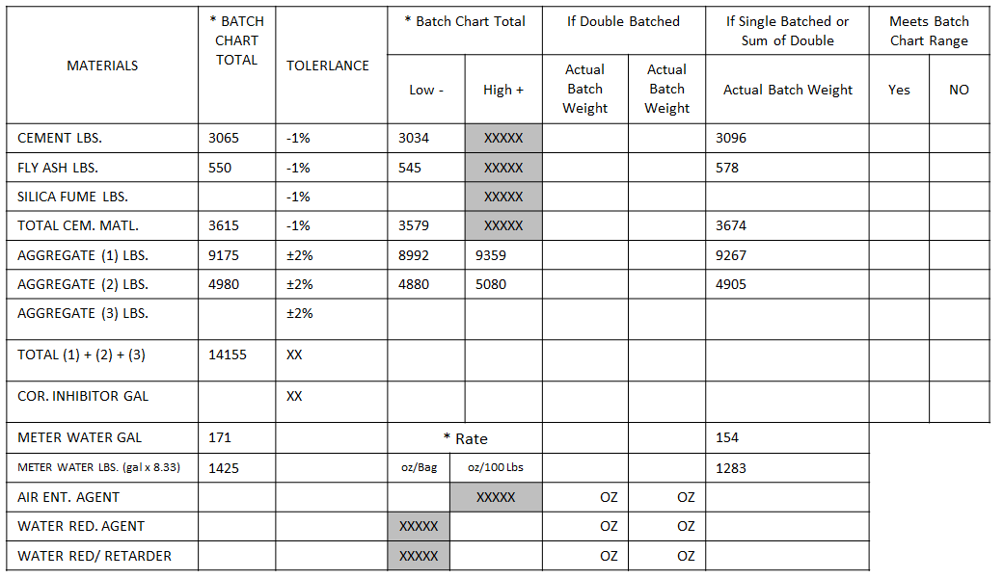
STEP 15. Evaluate the actual batch weights to determine if they meet the acceptable “Theoretical Batch Values”. Place a mark in the corresponding YES box for proportions that are within the acceptable range. Place a mark in the NO box for proportions that are outside of the acceptable range.
In this example, 3096 lbs cement exceeds the minimum acceptable value of 3034 lb, so the cement weight meets the tolerance. 9267 lbs of crushed stone falls between the acceptable low of 8992 lbs and the acceptable high of 9359, so the coarse aggregate meets tolerance.
X
X
X
X
X

Slide 27
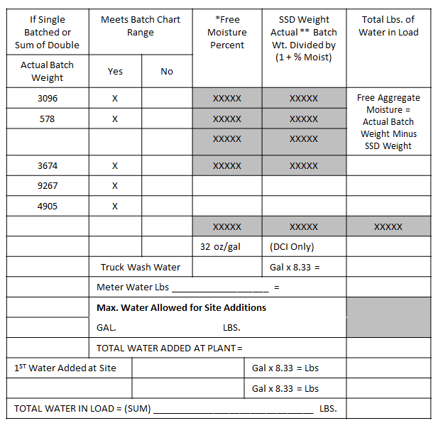
STEP 16a. Fill in the “Free Moisture Percent” spaces with the appropriate values.
The values for the aggregate moistures are obtained from the Batch Ticket or Batch Computer Screen.

Slide 28
 |  |  |  | DISPATCH TICKET NUMBER
 | TRUCK # | FILE # | USER |  | TICKET ID | BATCH TIME | DATE
 | 46 | 10.426 | C. Breeze | 159587 | 20907 | 12:06 | 10/31/2016
 |  | LOAD SIZE | MIX CODE | RETURNED QUANTITY | CUMMULATIVE YARDS
 |  | 5.00 CY | 31614E D | 0 | 10 Y
 |  | MATERIAL | DESIGN QTY (SSD/YD) | TARGET WEIGHT | BATCHED | % Var | % Moisture
 |  | Coarse Agg | 1844 lb | 9175 lb | 9267 lb | 1.00 | 0.50%
 |  | Int Agg |  |  |  |  | 0.00%
 |  | Fine Agg | 1036 lb | 4980 lb | 4905 lb | -1.51 | 4.00%
 |  | Total Agg (lbs) |  | 14155 lb
 |  | Cement | 613 lb | 3065 lb | 3096 lb | 1.01
 |  | Fly Ash | 110 lb | 550 lb | 578 lb | 5.09
 |  | WR | 2.5 oz/ 100 Lbs. | .00 oz | .00 oz
 |  | Air | 0.6 oz/bag | .00 oz | .00 oz
 |  | Water (lbs) | 334 lb | 1425 lb
 |  | Water (gal) |  | 171 gal | 154 gal
Mix Information As Batched

Slide 29
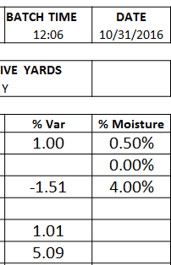
STEP 16a. Fill in the “Free Moisture Percent” spaces with the appropriate values.
0.005
0.040
For this example, the coarse aggregate moisture is 0.50% which corresponds to 0.005 as a decimal. The fine aggregate moisture is 4% or 0.04.

Slide 30
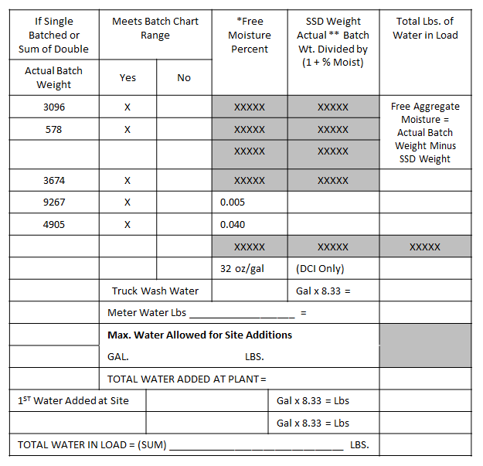
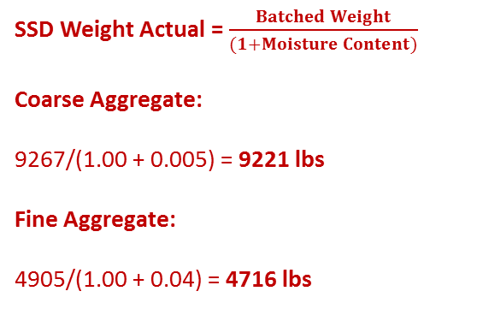
STEP 16b. Calculate the “SSD Weight” of the aggregates by following the Formula provided ** on the Form. 700.04. Round to the nearest pound.
SSD Weight Actual = $\frac{Batched Weight}{(1+Moisture Content)}$
Coarse Aggregate:
9267/(1.00 + 0.005) = 9221 lbs
Fine Aggregate:
4905/(1.00 + 0.04) = 4716 lbs
9221
4716

Slide 31
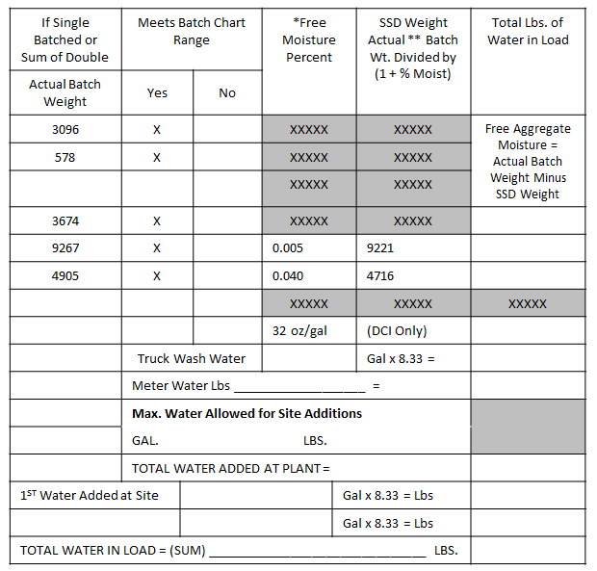
STEP 16c. Determine the “Free Aggregate Moisture” by subtracting the SSD Wt. from the “Actual Batch Weights” for each type of Aggregate.
Coarse Aggregate:
9267 – 9221 = 46
Fine Aggregate:
4905 – 4716 = 189
46
189

Slide 32
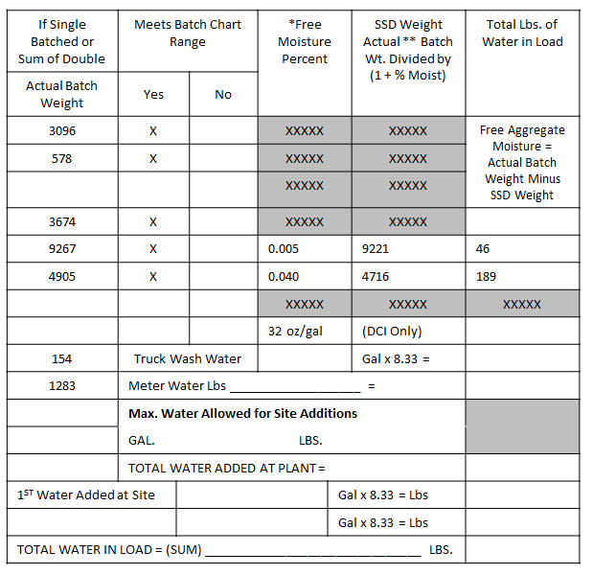
STEP 17. Transfer the actual amount of “Meter Water” added to the mix, from the “Actual Batch Weight” column.
In this example:
The weight is 1283 pounds.
1283

Slide 33

STEP 18. Obtain the “Total Water Added at the Plant” by summing the two “Free Aggregate Moistures” and the “Meter Water” weights.
46 + 189 + 1283 = 1518
1518

Slide 34
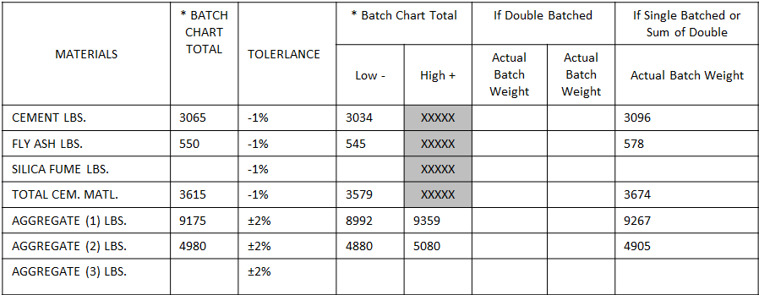
STEP 19. To determine the “Maximum Water Allowed for the Mix AS Batched”, multiply the correct w/c ratio by the “Actual Batch Wt. Total Cementitious Material”.
For this example,
The correct w/c ratio is 0.46 according to the SCDOT Structural Concrete Table in section 701.20 of the Standard Specifications.
0.46 x 3674 = 1690
Max Water Allowed for the Mix AS Batched
1690

Slide 35
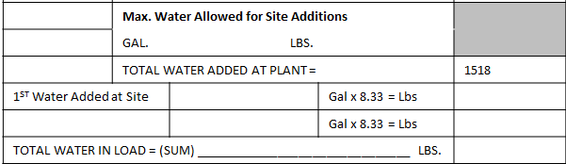
STEP 20. Determine the “Max Water Allowed for Site Additions” by subtracting the “Total Water Added at Plant” from the “Max Water Allowed for the Mix as Batched”. Convert the weight of water into gallons by dividing the weight by 8.33.
1690 – 1518 = 172 lbs
172 lbs/8.33 = 20.6 Gallons Do NOT Round Up to Next Gallon
Max Water Allowed for the Mix AS Batched | 1690
20
172

Slide 36
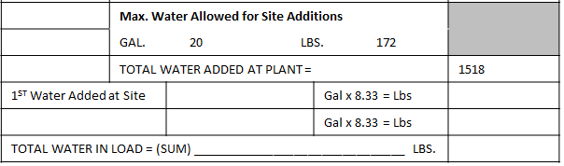
STEP 21. According to the Problem Statement, this truck load required a slump adjustment of two inches. The accepted formula for slump adjustments states that 1 yd³ of concrete will increase in slump by 1 inch for each 1 gallon of water added. (Inches to move x # of yd³s = Gallons Required.)
In this example, there are 5 yd³ of material for the slump to be increased by 2”
2 inches x 5 yd³ = 10 Gallons
10 Gallons x 8.33 = 83 lbs. of Water for 1st Site Addition
Repeat for the 2nd Water Added At Site if required.
10
83

Slide 37
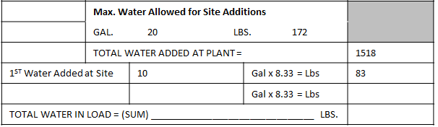
STEP 22. The Total Water in the Load (SUM) is determined by adding the Total Water Added at the Plant plus any on-site water additions.
Total Water in the Load” 1518 + 83 = 1601
1601

Slide 38
STEP 23. Calculate the Water to Cementitious Material Ratio by dividing the Total Water in the Load (1601 lbs) by the Total Cementitious Material’s Actual Batch Weight (3674 lbs.)
Ratio = | Total Water in Load (Lbs) | =
 | Total Cementitious Material (Lbs.)
1601 Lbs Water | =
3674 Lbs Cem. Matl.
0.44
STEP 24. Compare the w/c ratio for this load (0.44) to the w/c for this class of PCC (0.46).

Slide 39
STEP 24. It is the Field Inspector’s job to fill out all of the relevant information below for each Form 700.04.

Slide 40
0.019
3/15/2005
5000
2
5
10
11
John Q. Doe
0.46 x 3674 = 1690
3065
3034
3096
X
550
545
578
X
3615
3579
3674
X
9175
8992
9359
9267
X
0.005
9221
46
4980
4880
5080
4905
X
0.04
4716
189
14155
171
171-17=154
1425
154 x 8.33 = 1283
1283
23
0.60
90
2.5
20
172
1518
10
83
1601
0.44
1601
3674

Slide 41
Two external sources of information are required to complete the Form 700.04. They are the Structural Concrete Table (needed only for the water to cementitious material ratio) and a batch ticket or batch computer screen.

Slide 42

THINGS TO REMEMBER
Verify that the proper mix is being used.
Make sure that proper materials per mix design are being used.
Always ROUND DOWN – Gallon units only!
Make sure that proper mixing is complete before the truck leaves the plant

