Slide 1

PERFORMANCE MANAGEMENT:
Performance Management (EPMS) Policies
POLICIES & PROCEDURES
Know the policies and procedures that govern Employee Performance Management – Planning Stages (EPMS-PS) and EPMS Evaluations.

Slide 2
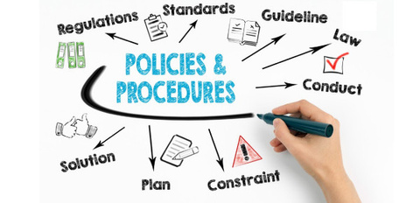

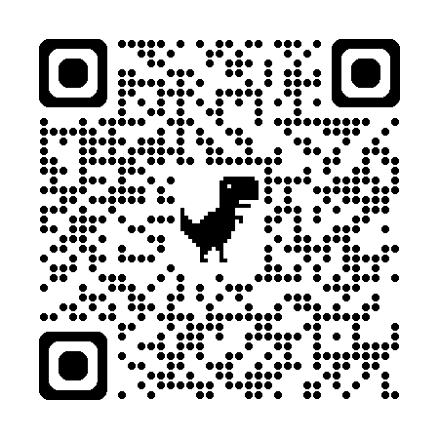
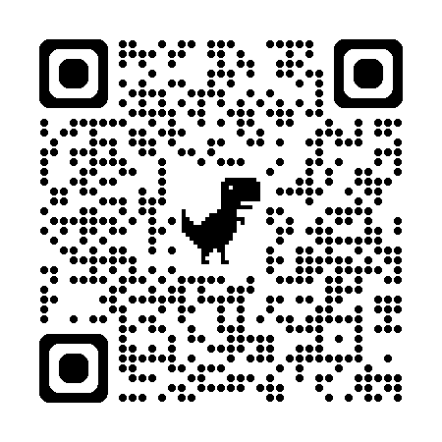
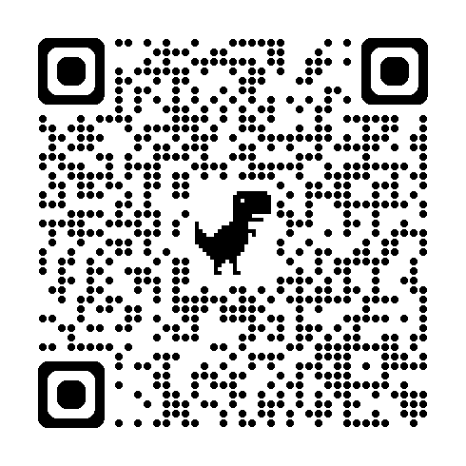
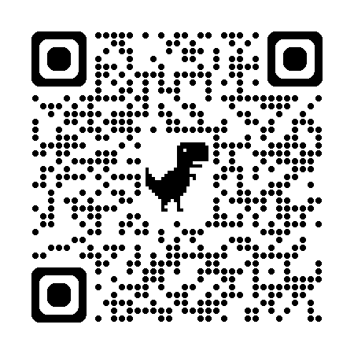
USC POLICIES
The University of South Carolina is committed to attracting, hiring, and retaining top-talent in alignment with our mission, vision, and objectives. This page outlines the policies and procedures that govern our performance management tools and processes ensuring consistency, fairness, and compliance with all applicable laws and regulations.
Access the Policies
HR Policy 1.36: Performance Evaluation for Classified and Unclassified Non-Academic Staff
Describes the policy and procedures for the evaluation of the job performance of classified and unclassified non-academic staff.
HR Policy 1.34: Evaluation of Officers of the University and Administrators Reporting to the President
HR Policy 1.42: Grievance
Defines who may file a grievance, what actions may be grieved, the procedure to file a grievance, how to file and appeal , and explains the university’s Review Committee.
Performance management documents may be entered into a grievance for an employee termination.
State Human Resources Regulations 19-704 and 19-715
USC is a state employer and governed by SC regulations. USC policy complies with SC HR regulations.
HR 1.5: Separation from Employment and Break in Service
The Separation from Employment and Break in Service Policy communicates to the employees of the University of South Carolina what actions constitute a separation or break in service.

