Slide 1

PERFORMANCE MANAGEMENT:
Set Expectations and Guide Progress
PROCESSES
Understand how to create an effective and compliant EPMS-PS and guide and support employee progress throughout the performance management cycle.

Slide 2
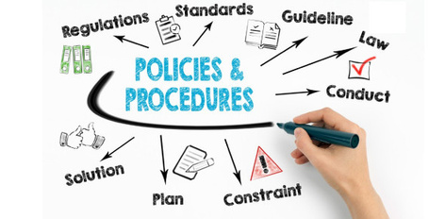

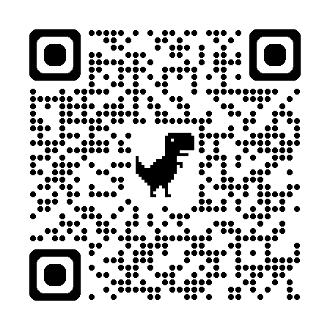
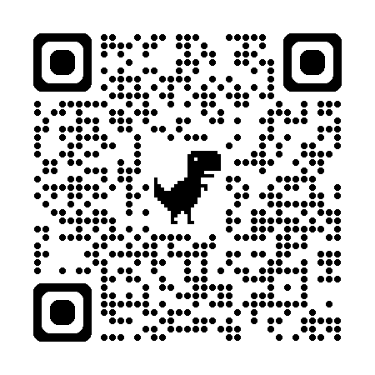
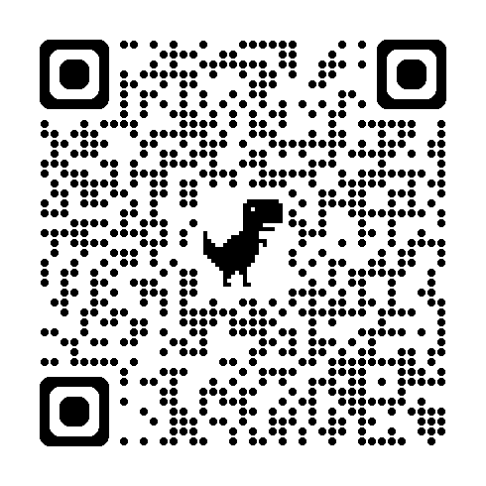
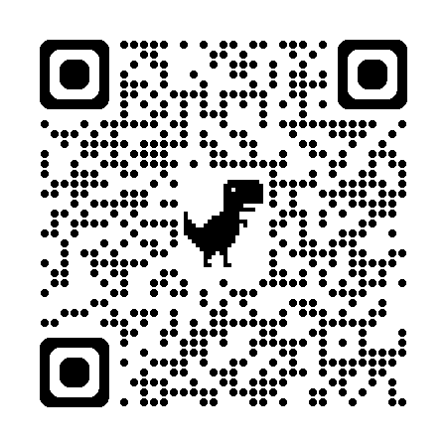
USC POLICIES
The University of South Carolina is committed to attracting, hiring, and retaining top-talent in alignment with our mission, vision, and objectives. This page outlines the policies and procedures that govern our performance management tools and processes ensuring consistency, fairness, and compliance with all applicable laws and regulations.
Access the Policies
HR Policy 1.36: Performance Evaluation for Classified and Unclassified Non-Academic Staff
Describes the policy and procedures for the evaluation of the job performance of classified and unclassified non-academic staff.
HR Policy 1.34: Evaluation of Officers of the University and Administrators Reporting to the President
HR Policy 1.42: Grievance
Defines who may file a grievance, what actions may be grieved, the procedure to file a grievance, how to file and appeal , and explains the university’s Review Committee.
Performance management documents may be entered into a grievance for an employee termination.
State Human Resources Regulations 19-704 and 19-715
USC is a state employer and governed by SC regulations. USC policy complies with SC HR regulations.
HR 1.5: Separation from Employment and Break in Service
The Separation from Employment and Break in Service Policy communicates to the employees of the University of South Carolina what actions constitute a separation or break in service.

Slide 3
PERFORMANCE MANAGEMENT CYCLE
Set Expectations. Guide Progress. Evaluate Outcomes.
A strong performance culture requires alignment across three essential practices: setting expectations, guiding progress, and evaluating outcomes.
Set Expectations through clear Position Descriptions, describing the role and duties, and a thoughtful Planning Stage, defining what success looks like. Without this foundation, employees may lack direction or misunderstand priorities.
Guide Progress with ongoing Coaching and Feedback, and when needed, provide structured Counseling or a Performance Improvement Plan (PIP). Without this support, performance issues go unaddressed, and development stalls.
Evaluate and Recognize Outcomes through the EPMS Review and meaningful Rewards and Recognition. Without evaluation and appreciation, achievements go unnoticed, and motivation declines.
When one element is missing, the whole system falters—expectations become unclear, progress is unsupported, and results are either ignored or misjudged. Together, these components create a continuous, fair, and motivating performance cycle that drives individual and organizational success.
Guide Progress
Evaluate and Recognize Outcomes
EPMS Review
Coaching and Feedback
Counseling and PIP
Set Expectations
Position Description (role)
Planning Stage (goals)
Rewards and Recognition
"Performance starts with clarity.
When expectations are clear, performance can be managed—through support, feedback, and accountability—not assumed."
Position Description (PD): Describes the role/work. Ensure it is accurate and current.
Articulate the role.
EPMS-Planning Stage (PS): Partner to set expectations & measures of success to create a roadmap for success.
Set expectations, look forward.
Feedback and coaching conversations: Document/recap employee progress and how you have helped them stay on track.
Help employees be successful.
EPMS Evaluation: Meet to review and document their accomplishments over the review cycle period.
Evaluate performance, look back.
Looks back
Looks forward

Slide 4
EPMS-PLANNING STAGE PROCESS
SET EXPECTATIONS AND LOOK FORWARD
Establishes a clear roadmap of goals, duties, and success criteria for the review period
Employee Performance Management System (EPMS) Form
Performance Feedback Assessment for Non-Covered Employees Form
WHEN TO COMPLETE
Must be completed at the beginning of each rating period (ideally within 30 days). Required for:
Annual goal-setting
Onboarding new employees
Role changes or promotions
Adding developmental goals (IDPs)
HOW: FOUR KEY ELEMENTS (REQUIRED)
Before you start, review the employee’s Position Description to ensure accuracy
1. Job Duties
  Include the most important duties and responsibilities from the position description
  Max six (6) duties, five (5) for non-supervisors
  Assign weight to each function (% of importance)
  Well-written Job Duty statements generally describe the purpose of the duty (what), how the duty is performed (how/methods), and sometimes include the reasons for doing it (why) when those reasons are not self-evident.
2. Performance Objectives
  Optional, max 15% assigned weight per objective
  Highlight important projects or assignments to be completed during the review period
3. Success Criteria (for each duty/objective)
  Describe how successful and exceptional performance for the job duties and objectives will be evaluated
    Successful: Represents the standard required to meet the expectations of the job duty/objective.
      It is not average performance; it is successful performance.
      Correlation to a Report Card: The employee earned an “A” or a grade of 90-100.
    Exceptional: Goes above and beyond the standard required to meet expectations.
      It demonstrates extraordinary contributions, creativity, or initiative that significantly impact the team or organization. You’ve not only met the expectations, but you've exceeded them in a way that sets a new benchmark for excellence.
      Correlation to a Report Card: The employee earned an “A+” or extra credit over 100.
  Collaboratively define what “Successful” and “Exceptional” performance looks like
  Identify and communicate what methods you will use to measure their success.
    Ex. 360 feedback, feedback from other customers/partners/managers, reports, etc.
  Establish how often progress will be reviewed and discussed (e.g., monthly, quarterly)
    Document and communicate expectations regularly
4. Performance Characteristics
  Relate to job functions
  Include definitions to describe effective behavior in the job role
5. Weights: Assign weights to each duty and objective (total = 100%)
Lead with Candor. Coach with Purpose.
Supervisors should use the GROW model or another structured approach to guide regular developmental check-ins.

Slide 5
RECAP: JOB DUTY STATEMENTS
UNDERSTANDING JOB DUTY STATEMENTS
Job duty statements identify the functions of the position and generally answer 3 questions:
  WHAT is the action?
  WHY is the action being done?
  HOW is the action being done?
BEST PRACTICES
When creating job duty statements, ensure you adhere to the following best practices:
  Use quantitative terms when possible.
  Spell out acronyms & abbreviations the first time it appears followed by (acronym). Then you can use the acronym moving forward.
  Include supervisory details, if the position has supervisory responsibility.
  Duty percentages must collectively equate to 100%.
EXAMPLES: POORLY VS. WELL-WRITTEN SAMPLES
Poorly Written Job Duty Statement::
Maintains grounds and landscaped areas.
Well-Written Job Duty Statement:
Maintains grounds and landscaped areas (what) with riding and hand powered mowers on a weekly basis (how). Plays an integral role in maintaining USC’s designation as a ‘Tree Campus USA’ (why).
Poorly Written Job Duty Statement:
Trains and supervises subordinate employees.
Well-Written Job Duty Statement:
Trains subordinates on agency policies and applicable state and federal laws (what) to ensure compliance (why). This is accomplished by distributing manuals and leading in-house workshops (how).

Slide 6
SUCCESS CRITERIA
UNDERSTANDING SUCCESS CRITERIA
  Success Criteria (for each duty/objective):
  Describe how successful performance for the job duties and objectives will be evaluated
  Help employees understand “what a good job” looks like by describing how the effectiveness of performance will be evaluated.
BEST PRACTICES
When creating success criteria, ensure you adhere to the following best practices:
  Collaboratively define what “Successful” and “Exceptional” performance looks like for agreement and buy-in
  Identify and communicate what methods you will use to measure their success.
    Ex. 360 feedback, feedback from other customers/partners/managers, reports, etc.
  Establish how often progress will be reviewed and discussed (e.g., monthly, quarterly)
    Document and communicate expectations during these regular conversations
SUCCESS CRITERIA QUALITY CHECKLIST
Success Criteria Quality Checklist
Use this checklist to ensure your success criteria are effective and meaningful:
  Is it measurable or observable?
  Is it clearly tied to a specific job duty or objective?
  Is it within the employee’s control?
  Does it describe what successful and exceptional performance look like?
  Does it avoid subjective or vague terms (e.g., “prompt,” “friendly,” “as needed”)?
Characteristics of Effective Measures
The most effective performance measures are:
  Sensitive: Capable of detecting meaningful differences in performance
  Consistent (Reliable): Collected and evaluated the same way every time
  Accurate: Reflects the true value of performance as defined by the role
Evidence Sources for Objectivity
Use tangible, traceable evidence whenever possible:
  Direct observation
  Reports and records
  Completed work samples, project summaries, narratives
  Feedback from others (e.g., peers, clients)
Ensure the criteria:
  Are attainable in the context of the employee’s workload
  Demonstrate competency rather than chance or dependency on other(s)
Resource: Success Criteria Library
What words should be avoided when writing success criteria?

Slide 7
PERFORMANCE CHARACTERISTICS
UNDERSTANDING PERFORMANCE CHARACTERISTICS
These characteristics represent the core behaviors and values expected of university employees to be successful in their roles. Each performance characteristic should be evaluated based on observable actions demonstrated throughout the review period and rated as either “Successful” or “Unsuccessful.”
Each characteristic should include a clear definition and a set of behavioral indicators to support meaningful dialogue and consistent evaluation during performance reviews.
PERFORMANCE CHARACTERISTICS EXAMPLES
Reference the Performance Characteristics Library to select performance characteristics for the employee’s role. What behaviors will be needed for this employee to be successful in this role?
From the library tool:
Accountability
Takes ownership of work, decisions, and outcomes. Accepts responsibility for successes and setbacks and aligns actions with institutional values and expectations.
Acknowledges personal contributions to outcomes—positive or negative—without shifting blame
Accepts feedback constructively and applies it to improve future performance
Makes ethical decisions aligned with institutional standards, even when inconvenient
Escalates issues or risks proactively rather than ignoring them
Demonstrates consistency between words and actions (i.e., "walks the talk")
Takes initiative to resolve problems within one’s scope of influence
Communicates transparently about challenges, progress, or mistakes
Interpersonal Influence
Builds rapport and uses emotional intelligence, communication skills, and relationship awareness to shape outcomes and gain support. Adapts approach to engage others, resolve differences, and move ideas forward constructively.
Builds positive relationships across levels, functions, and backgrounds
Uses persuasion and diplomacy to gain buy-in without relying on authority
Adapts tone, style, and messaging to fit the audience and context
Navigates sensitive conversations tactfully and constructively
Recognizes and responds to nonverbal cues and emotional dynamics in group settings
Anticipates objections and tailors messaging to address concerns or motivations
Service Excellence
Provides high-quality support and follows through with professionalism. Maintains responsiveness and courtesy in interactions with internal and external stakeholders.
Responds promptly and courteously to student, faculty, or staff requests
Follows up to ensure issues are resolved to satisfaction
Maintains a positive and solution-oriented demeanor, even under pressure
Proactively identifies service gaps or barriers and addresses them
Represents the university with professionalism in all external interactions
PRO TIP: Utilize USC secure AI resources and tools to assist you in writing successful and exceptional success criteria and performance characteristics
For additional guidance, contact your coll/div HR Representative or DHR-Employee Relations.

