Slide 1

PERFORMANCE MANAGEMENT:
Evaluate Outcomes
PROCESSES
Understand how to create effective and compliant EPMS-Evaluations.

Slide 2
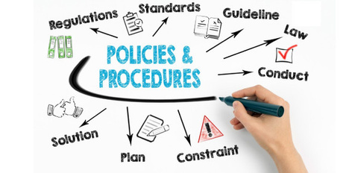

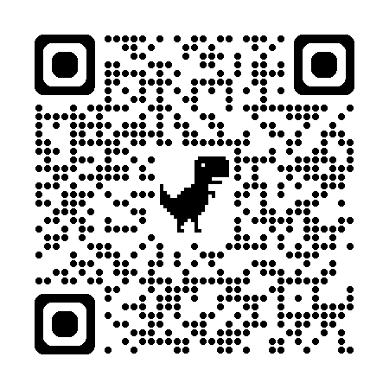
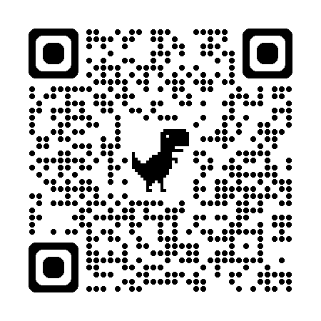
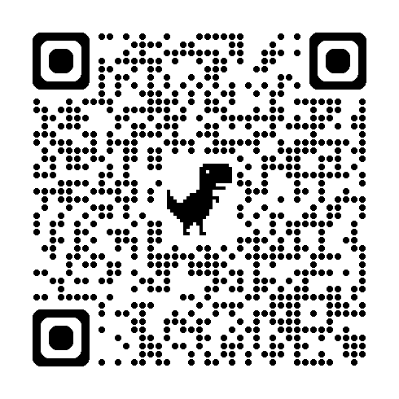
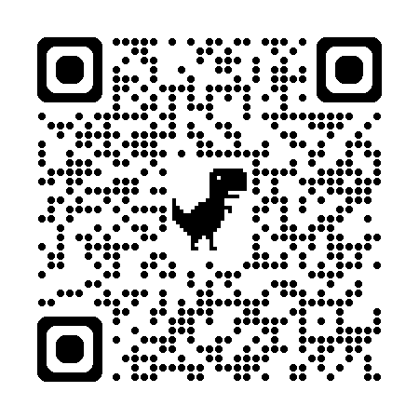
USC POLICIES
The University of South Carolina is committed to attracting, hiring, and retaining top-talent in alignment with our mission, vision, and objectives. This page outlines the policies and procedures that govern our performance management tools and processes ensuring consistency, fairness, and compliance with all applicable laws and regulations.
Access the Policies
HR Policy 1.36: Performance Evaluation for Classified and Unclassified Non-Academic Staff
Describes the policy and procedures for the evaluation of the job performance of classified and unclassified non-academic staff.
HR Policy 1.34: Evaluation of Officers of the University and Administrators Reporting to the President
HR Policy 1.42: Grievance
Defines who may file a grievance, what actions may be grieved, the procedure to file a grievance, how to file and appeal , and explains the university’s Review Committee.
Performance management documents may be entered into a grievance for an employee termination.
State Human Resources Regulations 19-704 and 19-715
USC is a state employer and governed by SC regulations. USC policy complies with SC HR regulations.
HR 1.5: Separation from Employment and Break in Service
The Separation from Employment and Break in Service Policy communicates to the employees of the University of South Carolina what actions constitute a separation or break in service.

Slide 3
PERFORMANCE MANAGEMENT CYCLE
Set Expectations. Guide Progress. Evaluate Outcomes.
A strong performance culture requires alignment across three essential practices: setting expectations, guiding progress, and evaluating outcomes.
Set Expectations through clear Position Descriptions, describing the role and duties, and a thoughtful Planning Stage, defining what success looks like. Without this foundation, employees may lack direction or misunderstand priorities.
Guide Progress with ongoing Coaching and Feedback, and when needed, provide structured Counseling or a Performance Improvement Plan (PIP). Without this support, performance issues go unaddressed, and development stalls.
Evaluate and Recognize Outcomes through the EPMS Review and meaningful Rewards and Recognition. Without evaluation and appreciation, achievements go unnoticed, and motivation declines.
When one element is missing, the whole system falters—expectations become unclear, progress is unsupported, and results are either ignored or misjudged. Together, these components create a continuous, fair, and motivating performance cycle that drives individual and organizational success.
Guide Progress
Evaluate and Recognize Outcomes
EPMS Review
Coaching and Feedback
Counseling and PIP
Set Expectations
Position Description (role)
Planning Stage (goals)
Rewards and Recognition
"Performance starts with clarity.
When expectations are clear, performance can be managed—through support, feedback, and accountability—not assumed."
Position Description (PD): Describes the role/work. Ensure it is accurate and current.
Articulate the role.
EPMS-Planning Stage (PS): Partner to set expectations & measures of success to create a roadmap for success.
Set expectations, look forward.
Feedback and coaching conversations: Document/recap employee progress and how you have helped them stay on track.
Help employees be successful.
EPMS Evaluation: Meet to review and document their accomplishments over the review cycle period.
Evaluate performance, look back.
Looks back
Looks forward

Slide 4
EPMS-EVALUATION PROCESS
EVALUATE PERFORAMANCE AND LOOK BACK
Formally assesses the employee’s performance against previously agreed-upon success criteria communicated through the EPMS-Planning Stage using the EPMS tool:
Employee Performance Management System (EPMS) Form​
Performance Feedback Assessment for Non-Covered Employees Form
WHEN TO COMPLETE
Must be completed at the end of the rating period or the employee receives a "successful by default."
Probationary: 1 year from the hire date unless prior state service. Submit up to 30 days early.
Short-Year Review: for employees transitioning to a Universal Review Date (URD) and less than 12 months
Universal Review Date (URD): Performance rated annually based on designated URD (2/1, 5/1, 8/1, 11/1). May submit up to 90 days early.
HOW: COMPLETE AND DELIVER THE REVIEW
Job Duties / Performance Objectives with Success Criteria: Use documentation and feedback collected throughout the review period to rate each duty accurately. Then, provide a concise explanation of the rating in the Actual Performance sections of each job duty/performance objective. This approach supports fair and consistent evaluations and helps reduce common rating errors.
Ratings:
Exceptional (2.5 – 3.0): Consistently exceeds success criteria
Successful (1.5 – 2.4): Meets success criteria
Unsuccessful (1.0 – 1.4): Fails to meet success criteria (must be preceded by counseling and documented opportunity to improve; consult Employee Relations first)
Performance Characteristics rated as Successful or Unsuccessful (not weighted in the final rating)
Text Boxes:
Optional: Comments on overall rating
Required: Summary of strengths, areas for improvement, and recommended development actions
Weights: Assign weights to each duty and objective (total = 100%)
If the evaluation is not completed by the required deadline, the employee will automatically receive a default rating of “Successful by Default.”
Best Practices
Schedule a private, dedicated meeting to review evaluation and ratings
Refer back to goals and expectations set during the Planning Stage.
Use evidence, not assumptions. Base ratings on observable behaviors and documented outcomes.
Focus on the whole picture. Consider consistency, progress, and impact—not just isolated wins or missteps.
Be fair and objective. Avoid bias, favoritism, or inflated ratings.
No surprises. Feedback should be ongoing throughout the year — the evaluation is a summary, not a reveal.
Recognize contributions. Acknowledge strengths, growth, and outcomes.
Prepare to discuss development. Use the review to set the stage for future success.
Invite employee input/reflection

Slide 5
SIGNATURES, ROUTING AND RETENTION
EPMS-PLANNING STAGE and EVALUATION
Supervisor (Rater): Completes and signs
Reviewer (Leader): Reviews for completeness and signs; may include separate comments but cannot change ratings
Employee: Signs to acknowledge discussion (not necessarily agreement)
May add comments or rebuttals
If refusing to sign, note refusal and involve a witness if possible
Wet signature or electronic signature is allowed
Record Retention: Provide a copy to the employee and retain documentation according to university policy.
Retain the Planning Stage locally.
Route the Evaluation to the Division of HR to scan and retain in the employee’s personnel file.
No changes may be made after being executed.
OPTIONAL EPMS-EVALUATION PROCESSES
Employee Self-Evaluation
In some cases, it may be beneficial for both the supervisor and employee to complete evaluations as part of a collaborative process. Two common approaches include:
Option 1: The employee completes a self-evaluation first. The supervisor reviews it, then meets with the employee to discuss before finalizing their own evaluation.
Option 2: The employee and supervisor complete their evaluations independently and then meet to compare and discuss. The supervisor then finalizes the official evaluation.
Note: A self-evaluation may not be appropriate if regular feedback from the supervisor was lacking throughout the year. In such cases, the employee may perceive the self-evaluation as a substitute for effective supervision.
College/Division Quality Review
EPMS Evaluations should be reviewed for accuracy and content by coll/div HR representatives prior to submitting to DHR-ER.
Verifying that all required sections are completed accurately, performance-related calculations are correct, and that no references to medical issues or conduct concerns are included in the evaluation.
RESOURCES
Crafting Clear Job Duties: Refer to the Job Duty Sample Resource for guidance.
Defining What Success Looks Like: Use the Success Criteria resource to establish measurable expectations.
Clarifying Performance Behaviors: Reference the Performance Characteristics resource to identify key behaviors that support job success and align with university values.
Avoiding Common Rating Pitfalls: Be mindful of rater errors such as halo effect, leniency, central tendency, and recency bias.
Need Support? Contact your coll/div HR Representative or Employee Relations for guidance and consultation.

