Slide 1

HR Forum
August 25, 2025

Slide 2
Agenda
Opening Remarks
Introduction of HRBP Leader
HRedefined Updates
Q&A session
Closing Remarks
COL/DIV HR
Embedded, operational HR, managing day-to-day HR functions; ensuring consistent implementation of policies & procedures
HRBP’S
Strategic partners and functional experts, focused on aligning people strategies with college/division objectives and driving long-term effectiveness

Slide 3
New HR Business Partner Leader: Carla Harkness
Education:
B.A. in Psychology, minor in Business Administration – Columbia College
M.A. in Human Resources – University of South Carolina (USC)
Career Highlights:
Served as Director of HR at the following organizations:
  USC School of Medicine
  Palmetto Health-USC Medical Group
  Prisma Health-USC Medical Group & USC School of Medicine
Experience: 25+ years in HR and organizational development
COL/DIV HR
Embedded, operational HR, managing day-to-day HR functions; ensuring consistent implementation of policies & procedures
HRBP’S
Strategic partners and functional experts, focused on aligning people strategies with college/division objectives and driving long-term effectiveness

Slide 4
HRedefined updates

Slide 5
Overview
Why it Started: Responding to concerns on transparency and inconsistent processes
Leadership Action: Conducted an organizational assessment to identify next steps
Proposed Solution: Introduced a new HR Business Partner (HRBP) model
Guidance: Segal partnered with leadership and committees to support HRBP model implementation
Current Progress: Hired HRBP Leader, hiring HRBPs underway, and developing change management structures for Spring 2026 implementation
HRBP’S
Strategic partners and functional experts, focused on aligning people strategies with college/division objectives and driving long-term effectiveness

Slide 6
HR Business Partner Model

Slide 7




Understanding HR partnerships
Operational HR Leader
Strategic Advisor and Partner to Executive Leaders; Connector to central and system HR
Establishes University-wide Strategies, Programs, and Policies
COL/DIV HR
Embedded, operational HR, managing day-to-day HR functions; ensuring consistent implementation of policies & procedures
HRBP’S
Strategic partners and functional experts, focused on aligning people strategies with college/division objectives and driving long-term effectiveness
EXPERT TEAMS
HR functional experts designing and optimizing programs and frameworks to advance the university’s strategic, people objectives

Slide 8
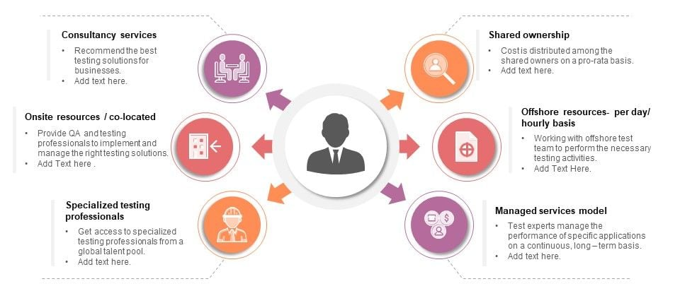
hr business partner focus areas
Understanding the high-level overview of HR Business Partners as Strategic Advisors
Strategic HR Consulting
HR Capability & Unit Alignment
HRBP
HR Program Implementation & Analysis
People Analytics & Interpretation
HRBP
Focus Areas
Organizational Development & Effectiveness
Change Advisors

Slide 9

Create the Change Mgt. Plan
Pre-Implementation Roadmap
5
Building Together: Assessing Needs & Hiring Right
Design the HRBP Operating Model
3
4
Define the Need
Assess the Current Model
1
2

Slide 10
5 phase implementation
Critical steps before piloting the structure
Define the Business Need & Objectives
  Identify key business challenges and align them with the need for strategic HR support
  Engage with business leaders to build support for the future model
  Align HR initiatives with broader organizational priorities
Assess the Current HR Operating Model
  Conduct an HR audit to assess current roles, processes, and service delivery
  Analyze current workload distribution
  Identify how HR is currently perceived across the business
Design the HRBP Role and Operating Model
  Craft a vision statement for the future model (how do you want HR to be perceived)
  Establish the HR overarching structure (identify support groups and COEs)
  Identify the HR framework (formal model) that will govern the HRBP structure (north star)
  Develop HRBP role profiles (technical skills, competencies, success metrics)
  Establish clear reporting lines, governance structures that outline COE and HRBP responsibilities

Slide 11
5 phase implementation, continued
Where we are
Building Together: Assessing Needs and Hiring Right
  Meet with current staff to determine training needs
  Advertise for HRBP roles
  Review the Expert Team structures, re-align to the future model (assessing operating procedures, current responsibilities, and implementing changes that support the HRBP model)
  Launch the interview and selection process for internal talent
Develop a Change Management Plan
  Conduct department assessments and alignment with service delivery
  Create communication and training plans
  Develop strategies for adoption
  Monitor and adjust change management strategies as the HRBP structure is implemented

Slide 12
Growing Together, Leading with purpose
Career Growth – More opportunities to learn and advance
Collaboration – Stronger, cross-functional HR partnerships
University Impact – Elevating HR to better serve our mission
Shared Support – Access to expertise and resources

Slide 13
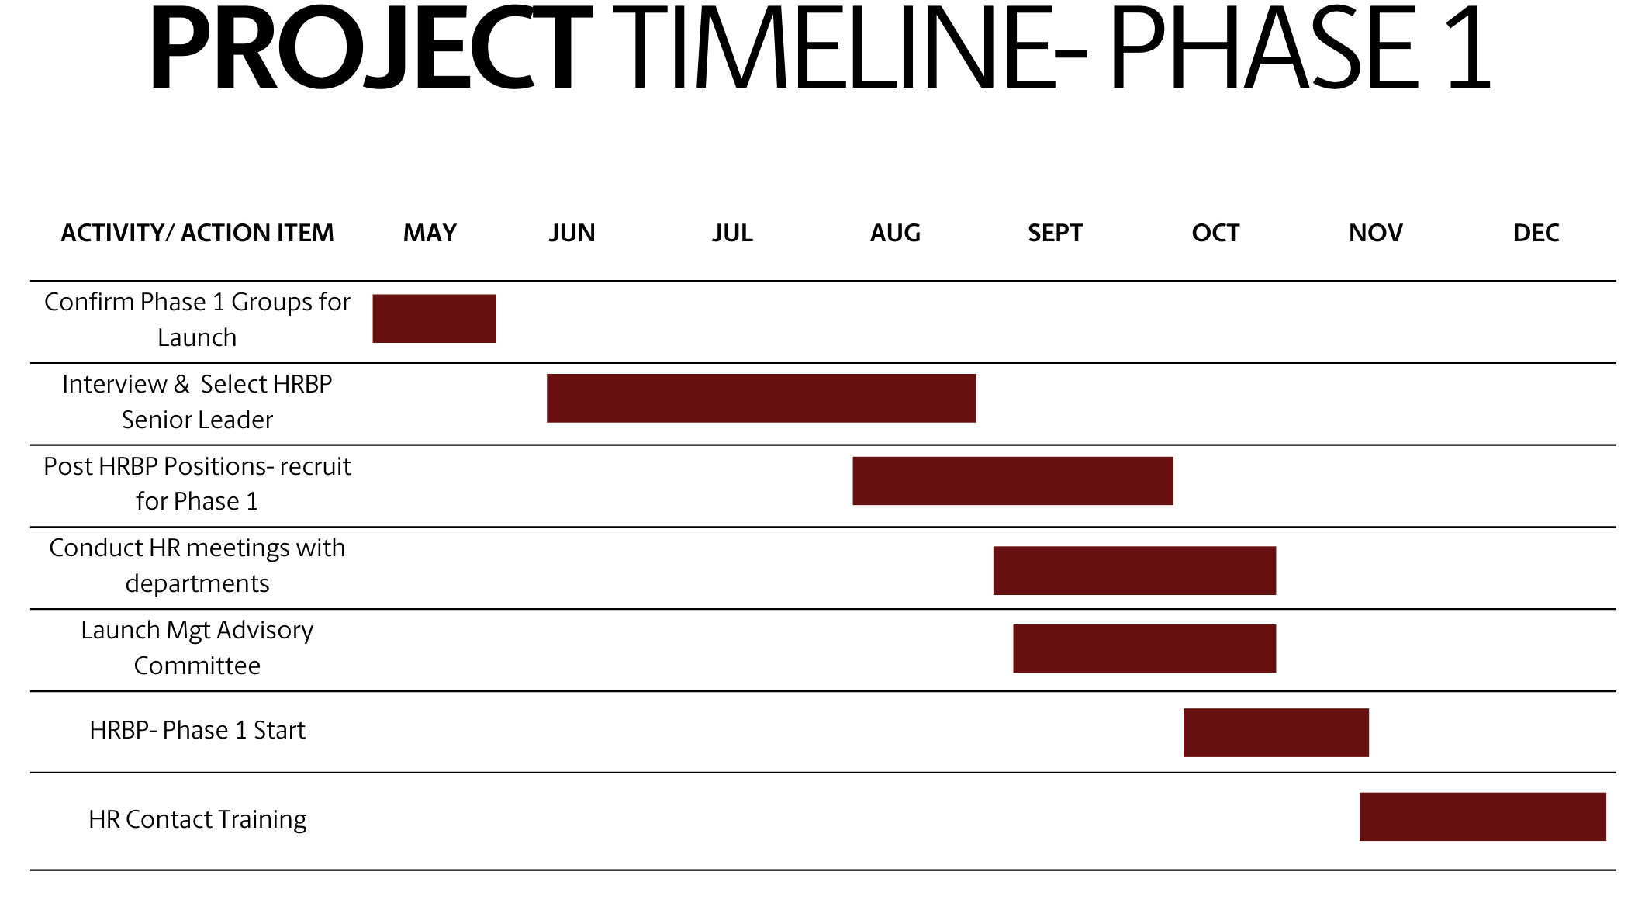

Slide 14
Questions?

Slide 15
Thank you

