Slide 1

Your voice matters. Impact South Carolina by sharing your thoughts and experiences as a full-time, research grant or
time-limited faculty or staff member in
USC’s Employee Insights Survey,
administered through email by ModernThink, from
March 17 to March 31, 2025.
Notes:
full-time, RGP and TLE employees can measure the full USC experience – benefits, etc.

Slide 2


Accreditation
Benefits & Compensation
Collaboration
Communication
Confidence in Senior Leadership
Department Chair/Supervisor Effectiveness
Faculty Experience (Faculty only)
Faculty and Staff Well-being
Inclusion, Belonging and Community
Job Satisfaction and Support
Mission and Pride
Performance Management
Policy, Resources, Efficiency
Professional Development
Shared Governance
18-20 minutes to complete
CHAMPION PARTICIPATION & SHARE YOUR THOUGHTS ON
THESE TOPICS
Notes:
Categories of survey questions

Slide 3


USC’s Employee Insights Survey is the ModernThink Great Colleges to Work For survey and one of the most respected employee engagement assessments in higher education, providing valuable insights into workplace culture, leadership, and job satisfaction.
ModernThink ensures your confidentiality
These survey results will establish a baseline for future feedback
You will help shape institutional priorities

Slide 4
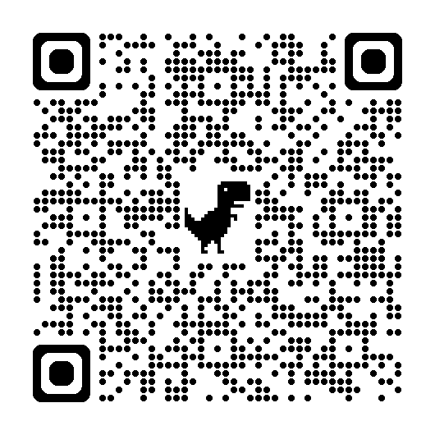
LEARN MORE….
USC’s Employee Insights Survey Webpage with FAQs
Leader’s Edge Forum
March 6, 3-4pm
Teams Link on Webpage
Kim Pruitt with Guest,
Provost Donna Arnett

